Slide 1
Clipping

Slide 2
Clipping Summary
It’s the process of finding the exact part of a polygon lying inside the view volume
To maintain consistency, clipping of a polygon should result in a polygon, not a sequence of partially unconnected lines
We will first look at 2 different 2D solutions and then extend one to 3D

Slide 3
Sutherland-Hodgman Algorithm
p
0
p
1
Clip to
top
Clip the polygon against each boundary of the clip region successively
Result is possibly NULL if polygon is outside
Can be generalised to work for any polygonal clip region, not just rectangular
p
4
p
2
p
3
Clip to
right
etc

Slide 4
Clipping To A Region
right clip
boundary
To find the new polygon
  iterate through each of the polygon edges and construct a new sequence of points
  starting with an empty sequence
  for each edge there are 4 possible cases to consider
P₂
P₁
P₀
P₃
clip
region

Slide 5
Clipping a polygon edge against the boundary
Given an edge P₀,P₁ we have 4 case. It can be:
  entering the clip region, add P and P₁
  leaving the region, add only P
  entirely outside, do nothing
  entirely inside, add only P1
Where P is the point of intersection
Visible
Side
p
p
1
p
0
p
p
1
p
0
p
1
p
0
p
1
p
0
IN
OUT

Slide 6
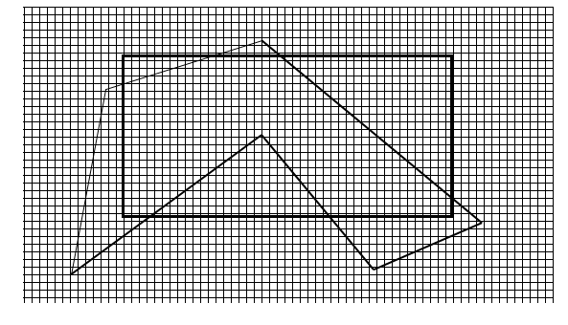
Clipping

Slide 7
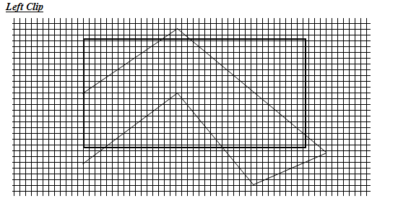
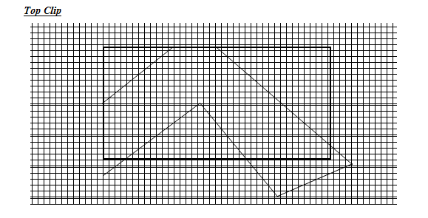

Slide 8
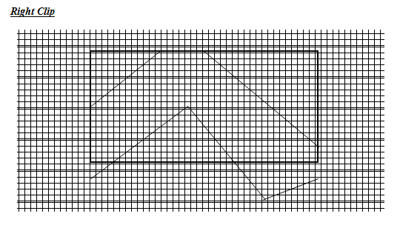
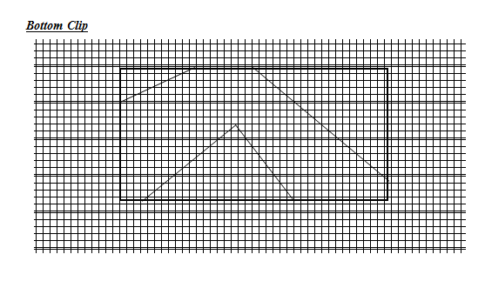

Slide 9
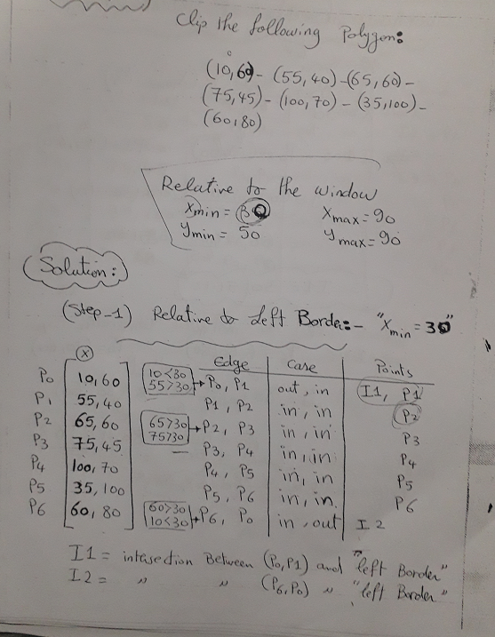
Example

Slide 10
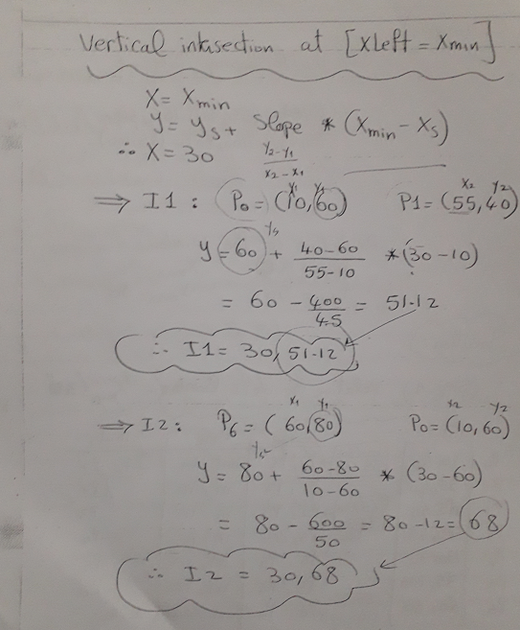

Slide 11
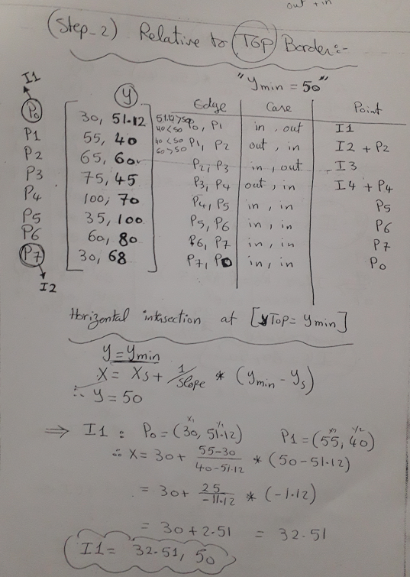

Slide 12
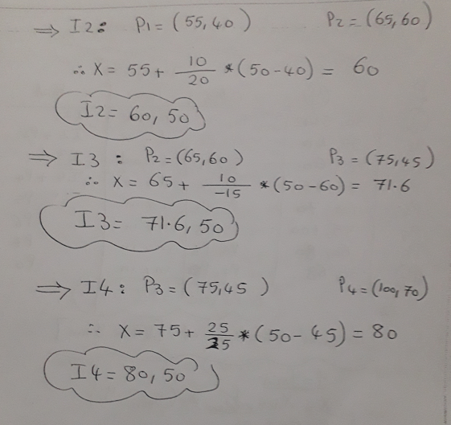

Slide 13
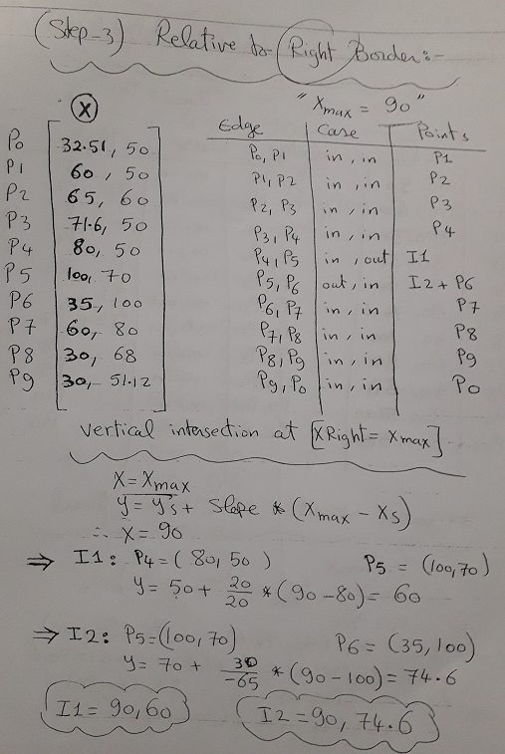

Slide 14
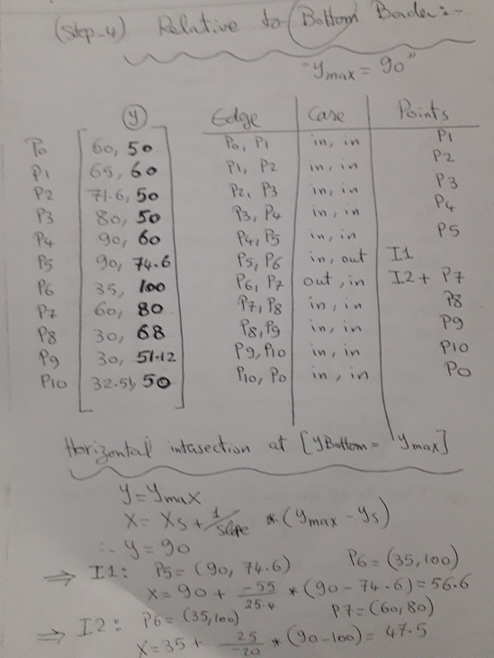

Slide 15
